Slide 1


IGT – Virtual Hackathon
25th March, 2022
Images, Brand information and logo’s used in this presentation are property(ies) of the respective businesses

Slide 2
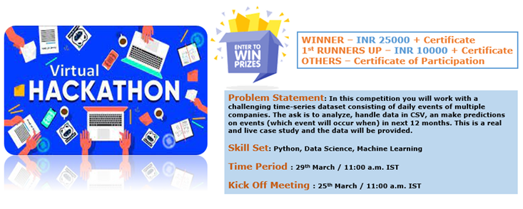

Slide 3

Scope Items
Identify potential repeating events over the historical pattern.
Be able to provide a percentage of accuracy for each event identified as repeating
Potential to predict “when it will occur”. This could be a day of week and week of month pattern or specific dates
Potential to predict the hotel it will book. (Do it if possible)
Forecast the potential size of the event (Do it if possible)

Slide 4
Data Fields
Market
Hotel Name
Hotel Address (this would be for number 4 above)
Event ID
Event Dates
Company/Account Name
Event Name
Largest Meeting Room used (Square Footage)
Total Square Footage Used
Estimated Attendees
Chain Scale
Brand Group
Brand

Slide 5
Changes in Data.
Events with the Company/Account as “unknown” should be excluded from the analysis.
These are events which are classified in our data as “SMERF – Social” by nature, they are generally unpredictable like a birthday party or Bah Mitzvah for a private entity and as such, unlikely to repeat versus those events associated with a defined “company”

Slide 6
Changes in Data.
Any dates that are tightly clustered and/or sequential are likely the same event (or sub events of a group) even though the event names may differ. Likely need to build logic around these events so we keep them grouped together and not considered multiple repeats in the same month.

Slide 7
Changes in Data.
Remove the Events if occurs only once.
Account / Company that has started a monthly meeting and has repeated for 15 months should be identified as a monthly repeating event even though the history is thin.

Slide 8
Changes in Data.
Companies which have returned to booking events would have the highest likelihood to be repeat business as they have resumed their “normal” booking pattern
Companies that have a strong booking pattern, but have not started to book events since March 2020 will be a lower likelihood to repeat, however, they may begin booking in the future as restrictions fade, so should not be omitted entirely
Any Company that does not have sufficient history in a given period should be omitted from being flagged as a “repeat”

Slide 9
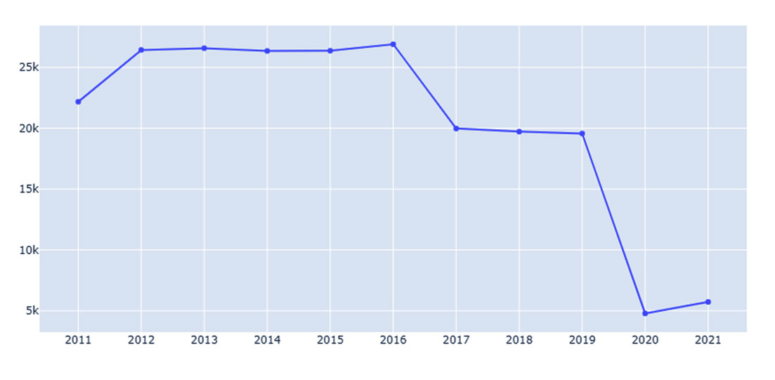
Atlanta Yearly Event

Slide 10
AI-ML Model Output
Parameter | Atlanta
Accuracy | 95%
Precision | 97%
F1 Score | 97%
Events occurring in next month | 6
Events occurring in next 6 months | 48
Events occurring in next 12 months | 359

